Slide 1
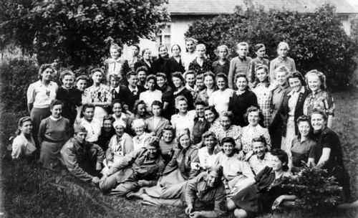
`
Survivors of the
Holocaust
By: David Nguyen

Slide 2
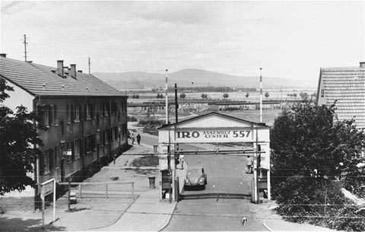
The Jewish communities no longer existed in much of Europe
Home was being looted or taken over by other people
Most end up in displace person, it was a camp set up in western Europe by the Allied authorities and the United Nations Relief and Rehabilitation Administration or UNRRA.
Most survivor began searching for their family

Slide 3
The UNRRA established the Central Tracing Bureau to help survivors locate relatives who had survived the concentration camps.
Public radio broadcasts and newspapers contained lists of survivors and their whereabouts.
Schools were soon established and teachers came from Israel and the United States to teach the children in the DP camps.
Orthodox Judaism also began its rebirth as yeshivot (religious schools)
Religious holidays became major occasions for gatherings and celebrations.

Slide 4
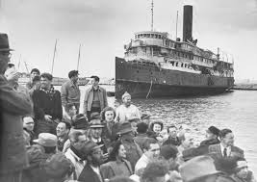
EMIGRATION
Most survivor decided to leave Europe and hundred of thousand established new live in Israel, the US, Canada, Australia, Great Britain, South America, and South Africa.
On May 14, 1948, the United States and the Soviet Union recognized the state of Israel. Congress also passed the Displaced Persons Act in 1948, authorizing 200,000 DPs to enter the United States.

Slide 5
With over 80,000 Jewish DPs in the United States, about 136,000 in Israel, and another 20,000 in other nations, including Canada and South Africa, the DP emigration crisis came to an end.
Almost all of the DP camps were closed by 1952 and the Jewish displaced persons began new lives in their new homelands around the world.

Slide 6
Preference
http://www.ushmm.org/wlc/en/article.php?ModuleId=10005462
Google Image

